Slide 1
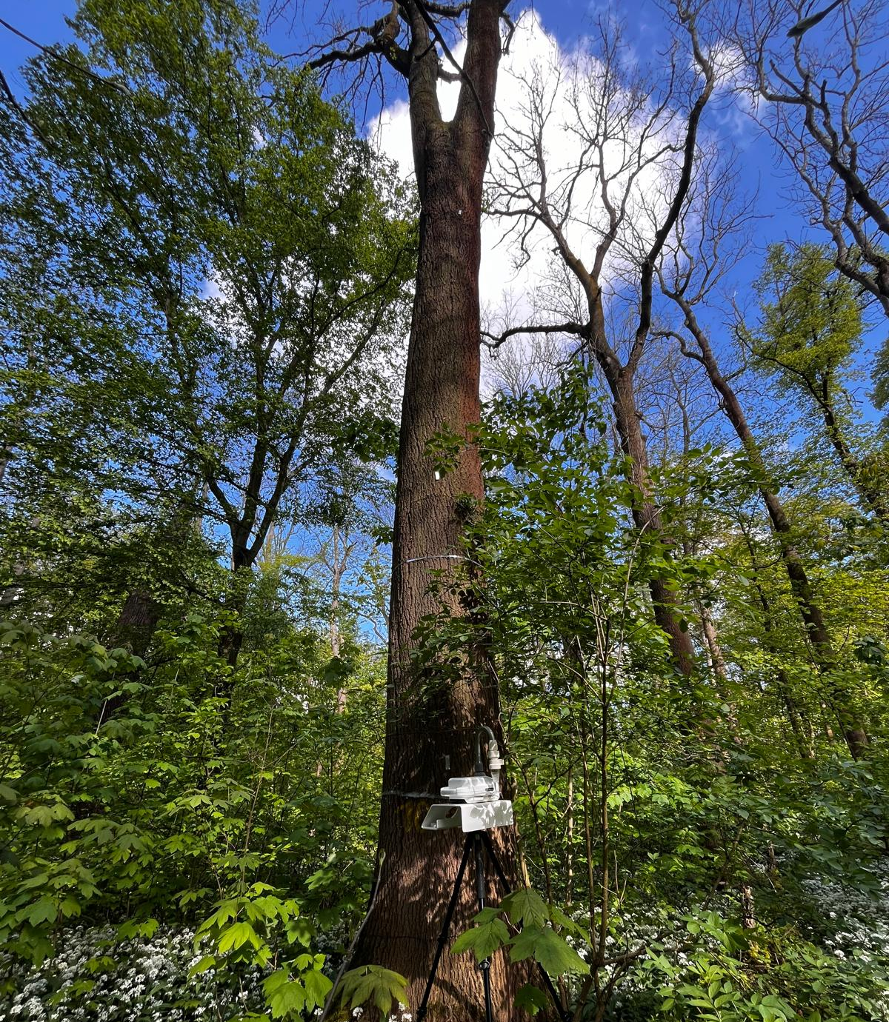




In-depth analysis of the origin of Primary Biological Aerosol Particles (PBAPs) in a temperate forest of Leipzig
Presented by- Bhavana Valath Bhuan Das¹
Co-authors- Martina Herrmann⁴, Beate Michalzik^{4,3}, Susanne Dunker^{2,4}, and Beatriz Sánchez-Parra^{1,4}
¹University of Leipzig, Institute of Biology, Johannisallee 21-23, D-04103, Leipzig, Germany
²Helmholtz Centre for Environmental Research - UFZ, Permoserstraße 15, D-04318, Leipzig, Germany
³Friedrich Schiller University Jena, 07743, Jena, Germany
⁴German Centre for Integrative Biodiversity Research (iDiv) Halle-Jena-Leipzig, Puschstrasse 4, D-04103, Leipzig, Germany

Slide 2
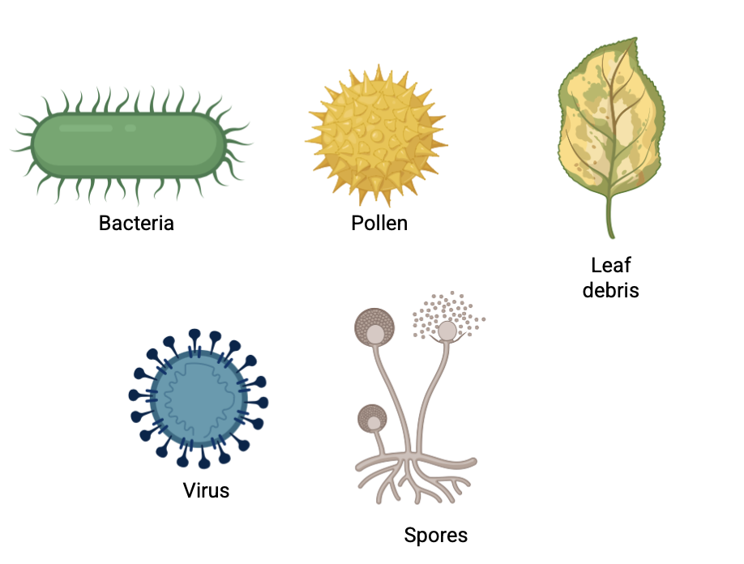

What are bioaerosols?
Primary Biological Aerosol Particles (PBAPs) are airborne biological components which are directly emitted from the biosphere into the atmosphere.
They include bacteria, fungi, viruses, spores, pollen, and plant or animal debris (Després et al., 2012).
Their dispersion is influenced by physical, meteorological, and biological factors.
Fig 1: Different types of PBAPs
(Made in BioRender)

Slide 3
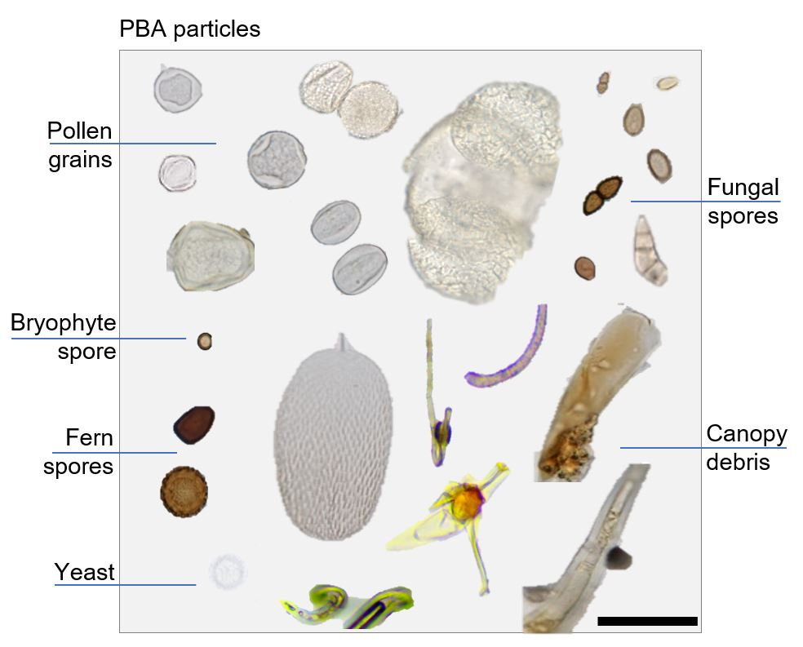
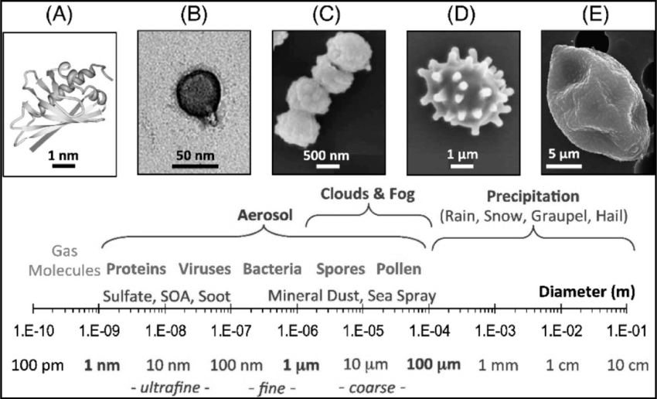
Fig 2: Characteristic size ranges of atmospheric particles and bioaerosols
(A) protein (B) virus, (C) bacteria, (D) fungal spore and (E) pollen grain
(Fröhlich-Nowoisky et al. 2016)
Fig 3: Microscopic images of giant aerosol particles found at ATTO
(Barbosa et al., 2022)

Slide 4
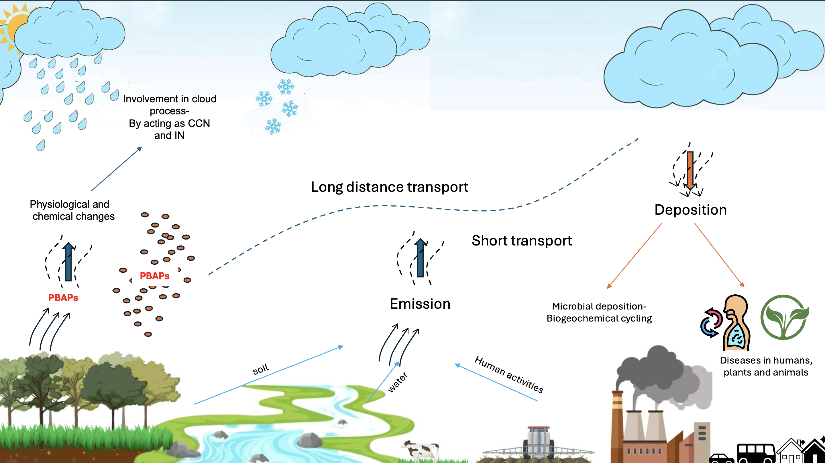
Why to study them?

Slide 5
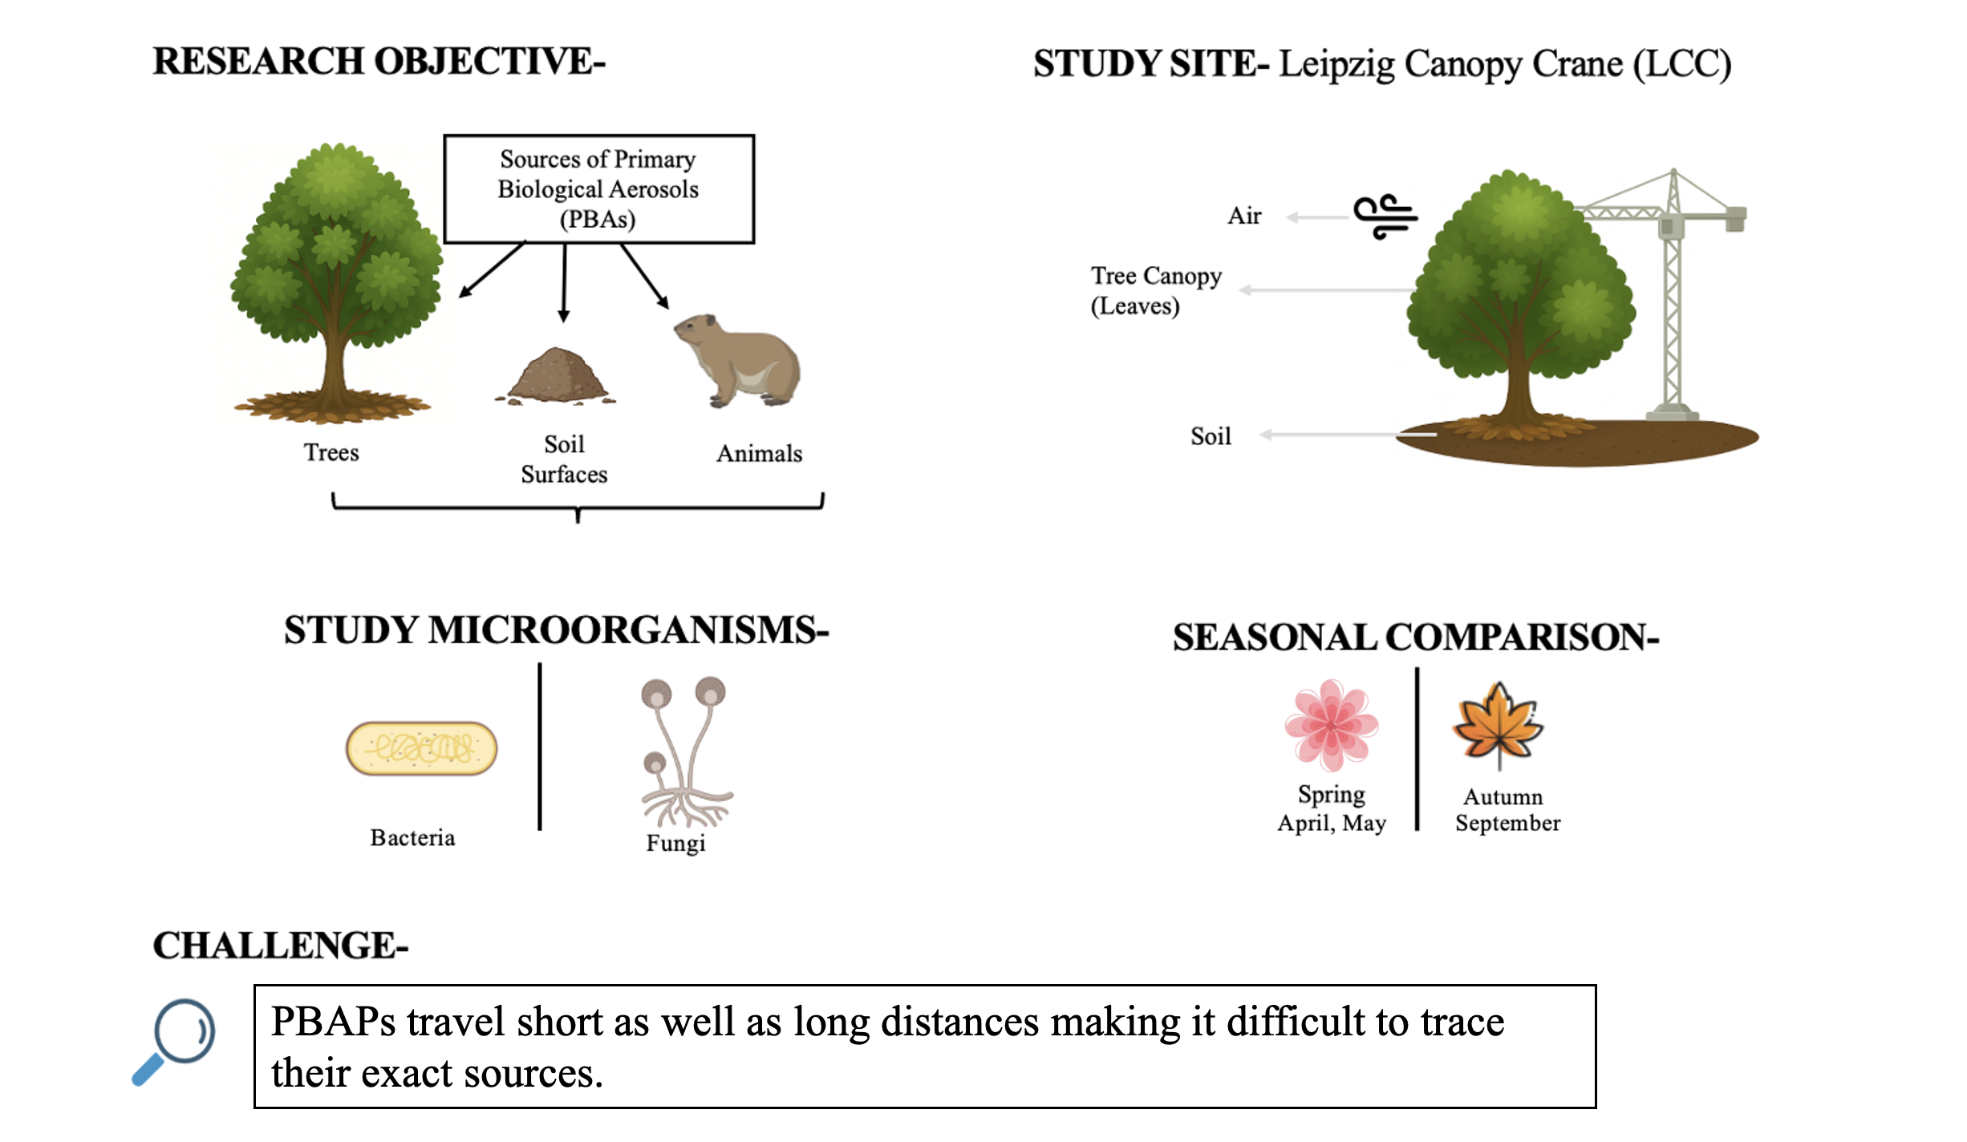
Sources of Primary Biological Aerosols (PBAPs)
Plants

Slide 6

Objectives: Tracing the origins of PBAPs
To compare air vs. soil microbial diversity and composition.
To determine the extent to which soil acts as a source of airborne microbes.
To evaluate the influence of seasonality and tree type on PBAPs diversity.
To advance the understanding of ecological role of the PBAPs contributing to broader insights into biodiversity dynamics and ecosystem functioning.

Slide 7
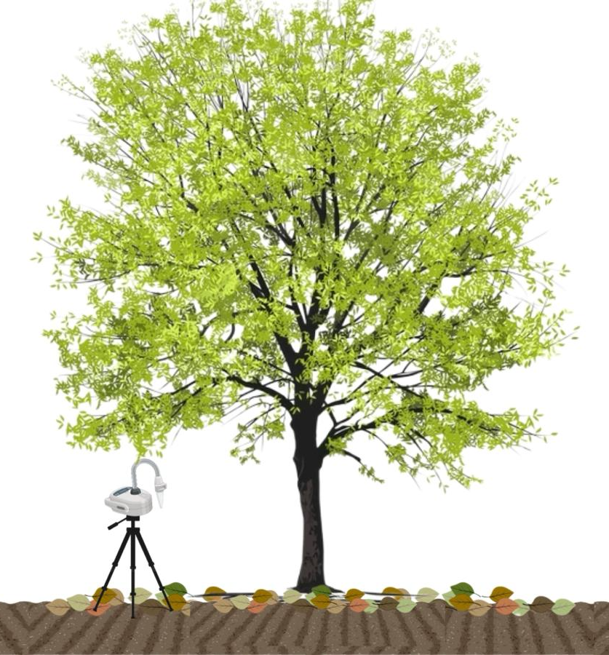
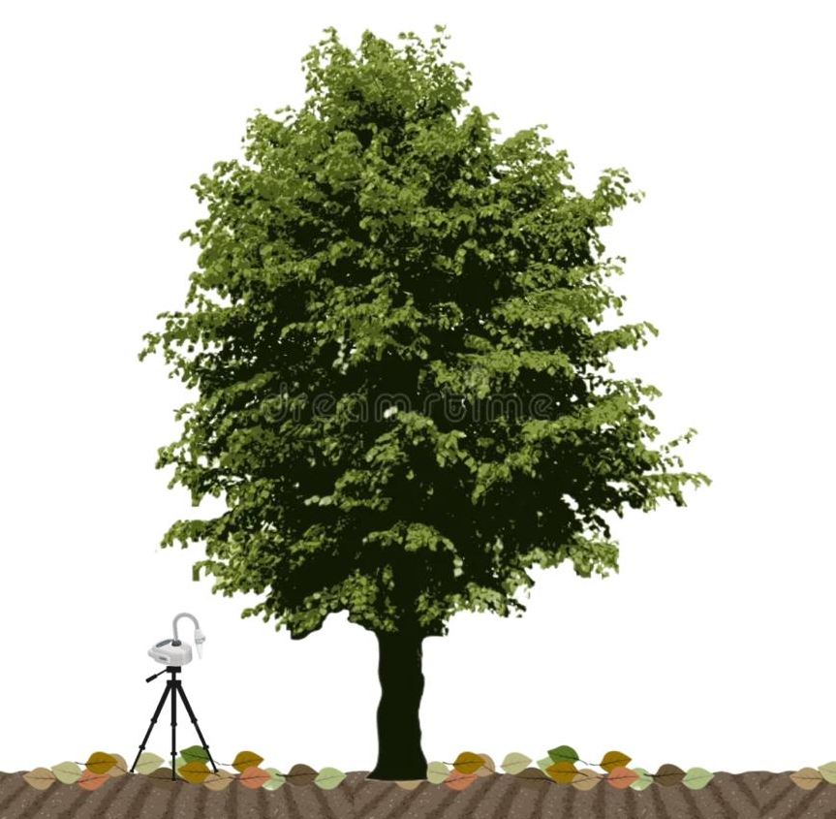

ASH
43m
LINDEN
ASH
133m
129m
LINDEN
Fig 4 : Map of Leipzig Awald forest
showing the measuring trees
OAK
OAK

Slide 8
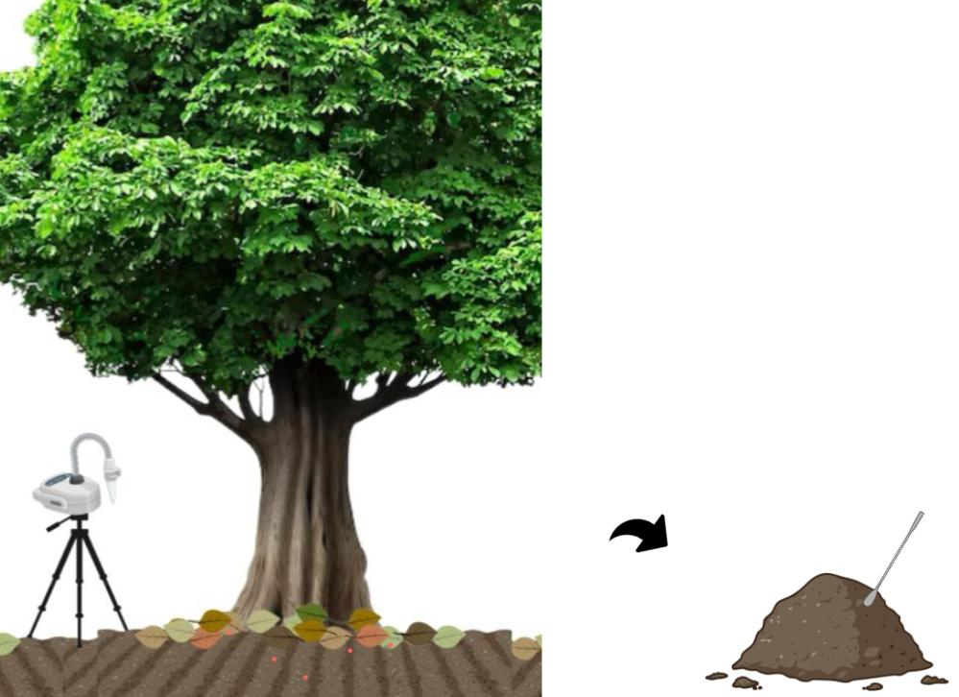
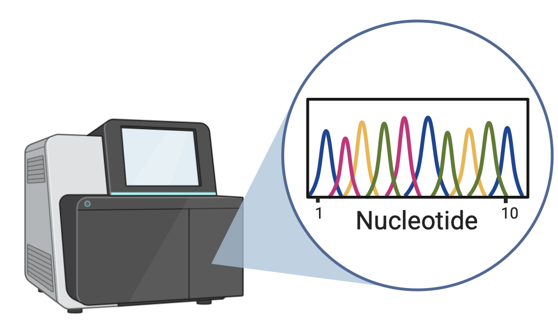

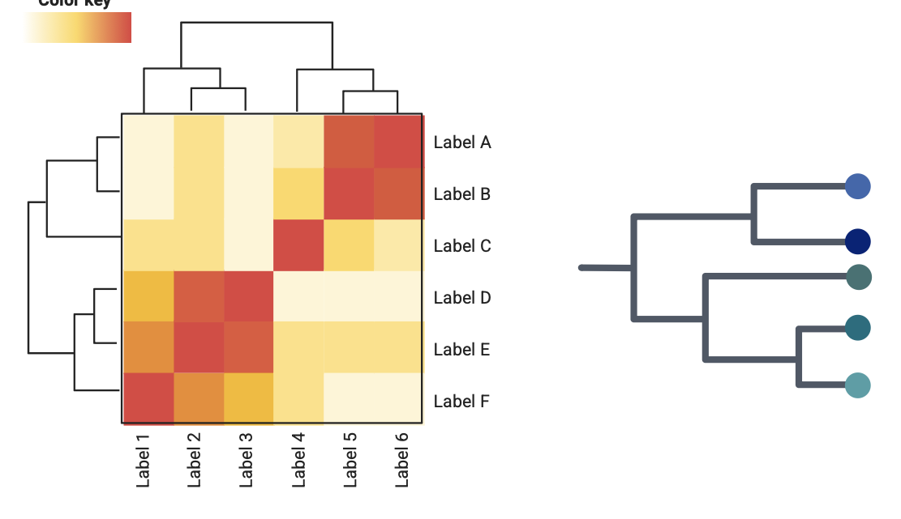
1
2
3
DNA extraction
Next Generation Sequencing (NGS)
Air and Soil sampling
qPCR
Flow cytometry
METHODOLOGY
4
Organic matter analysis
Amplicon Sequence Variance (ASV) analysis

Slide 9

Results
Alpha Diversity
Beta Diversity
Taxonomic classification

Slide 10
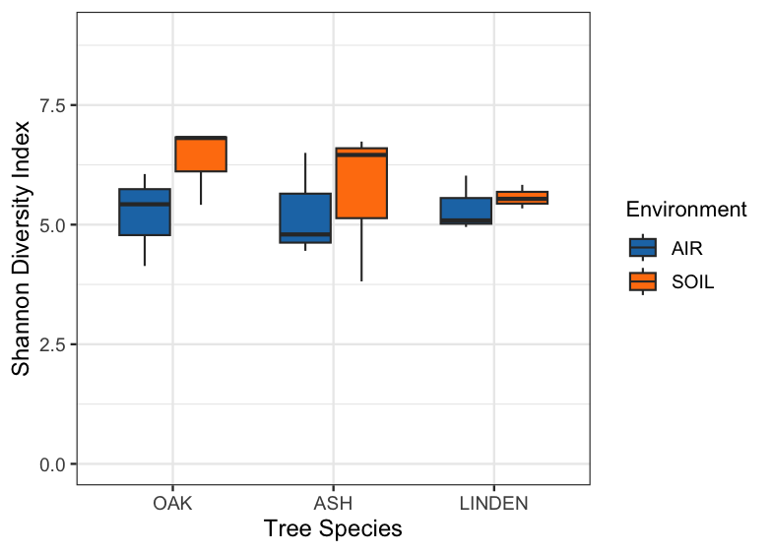
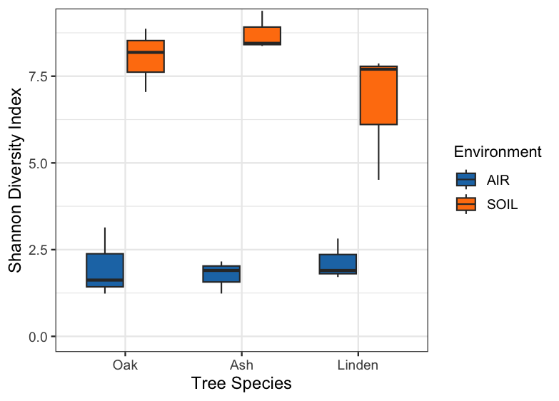
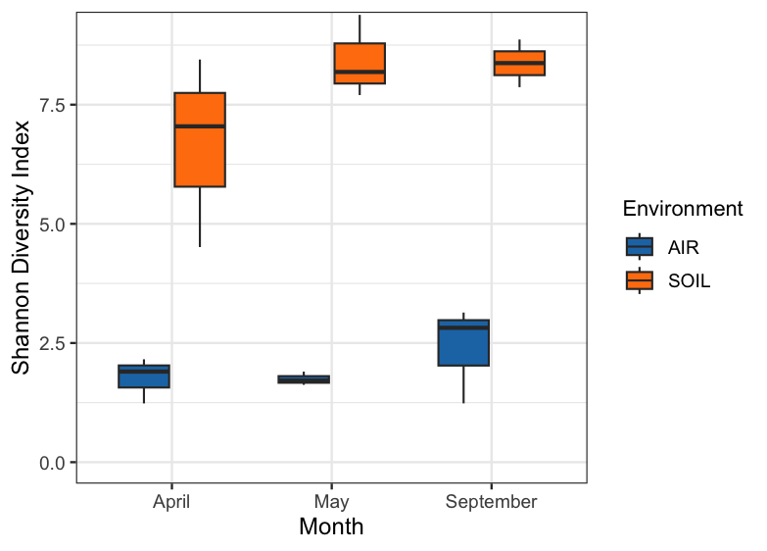
BACTERIA
FUNGI
Fig 6: Alpha diversity-Shannon index for bacterial samples
(based on month)
Fig 5: Alpha diversity-Shannon index for bacterial samples
i) based on tree type ii) based on month
Fig 6: Alpha diversity-Shannon index for Fungal samples
i) based on tree type ii) based on month

Slide 11
BACTERIA
FUNGI
Fig 7: Beta diversity-Unweighted UniFrac for bacteria (based on tree type and month)
Fig 8: Beta diversity-Unweighted UniFrac for fungi (based on tree type and month)

Slide 12
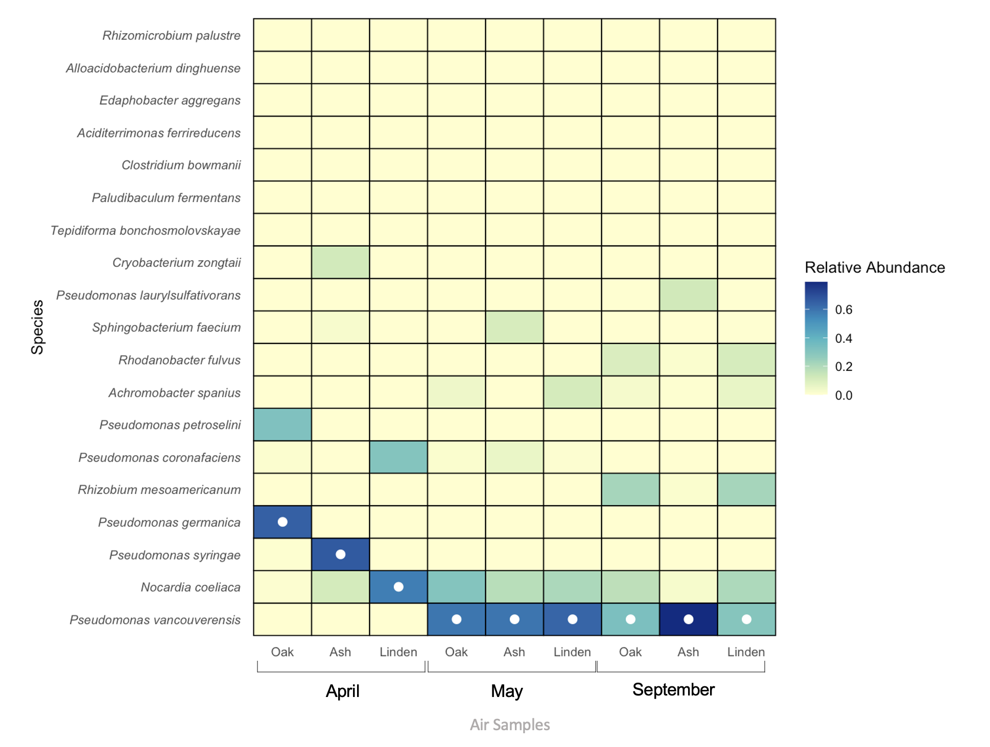
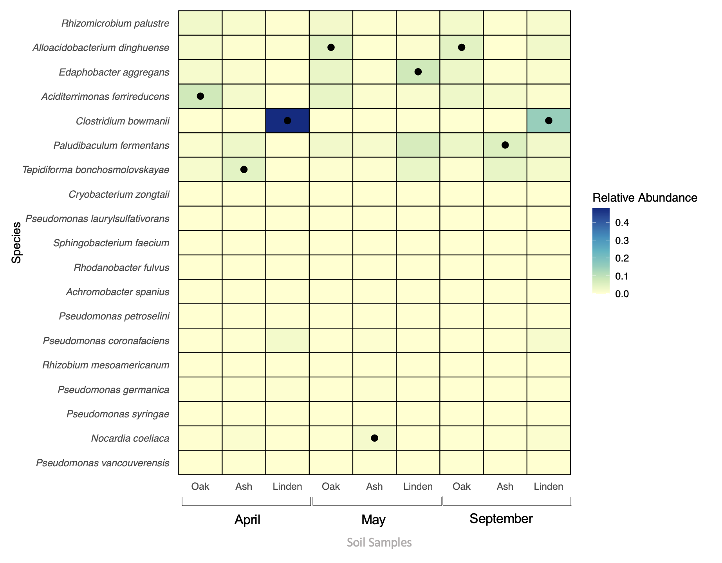
BACTERIA
Air
Soil
Fig 9: Heat Map comparing most dominant bacterial species

Slide 13
Fig 10: Comparison of mean relative abundance of the most dominant bacterial species in the air samples

Slide 14
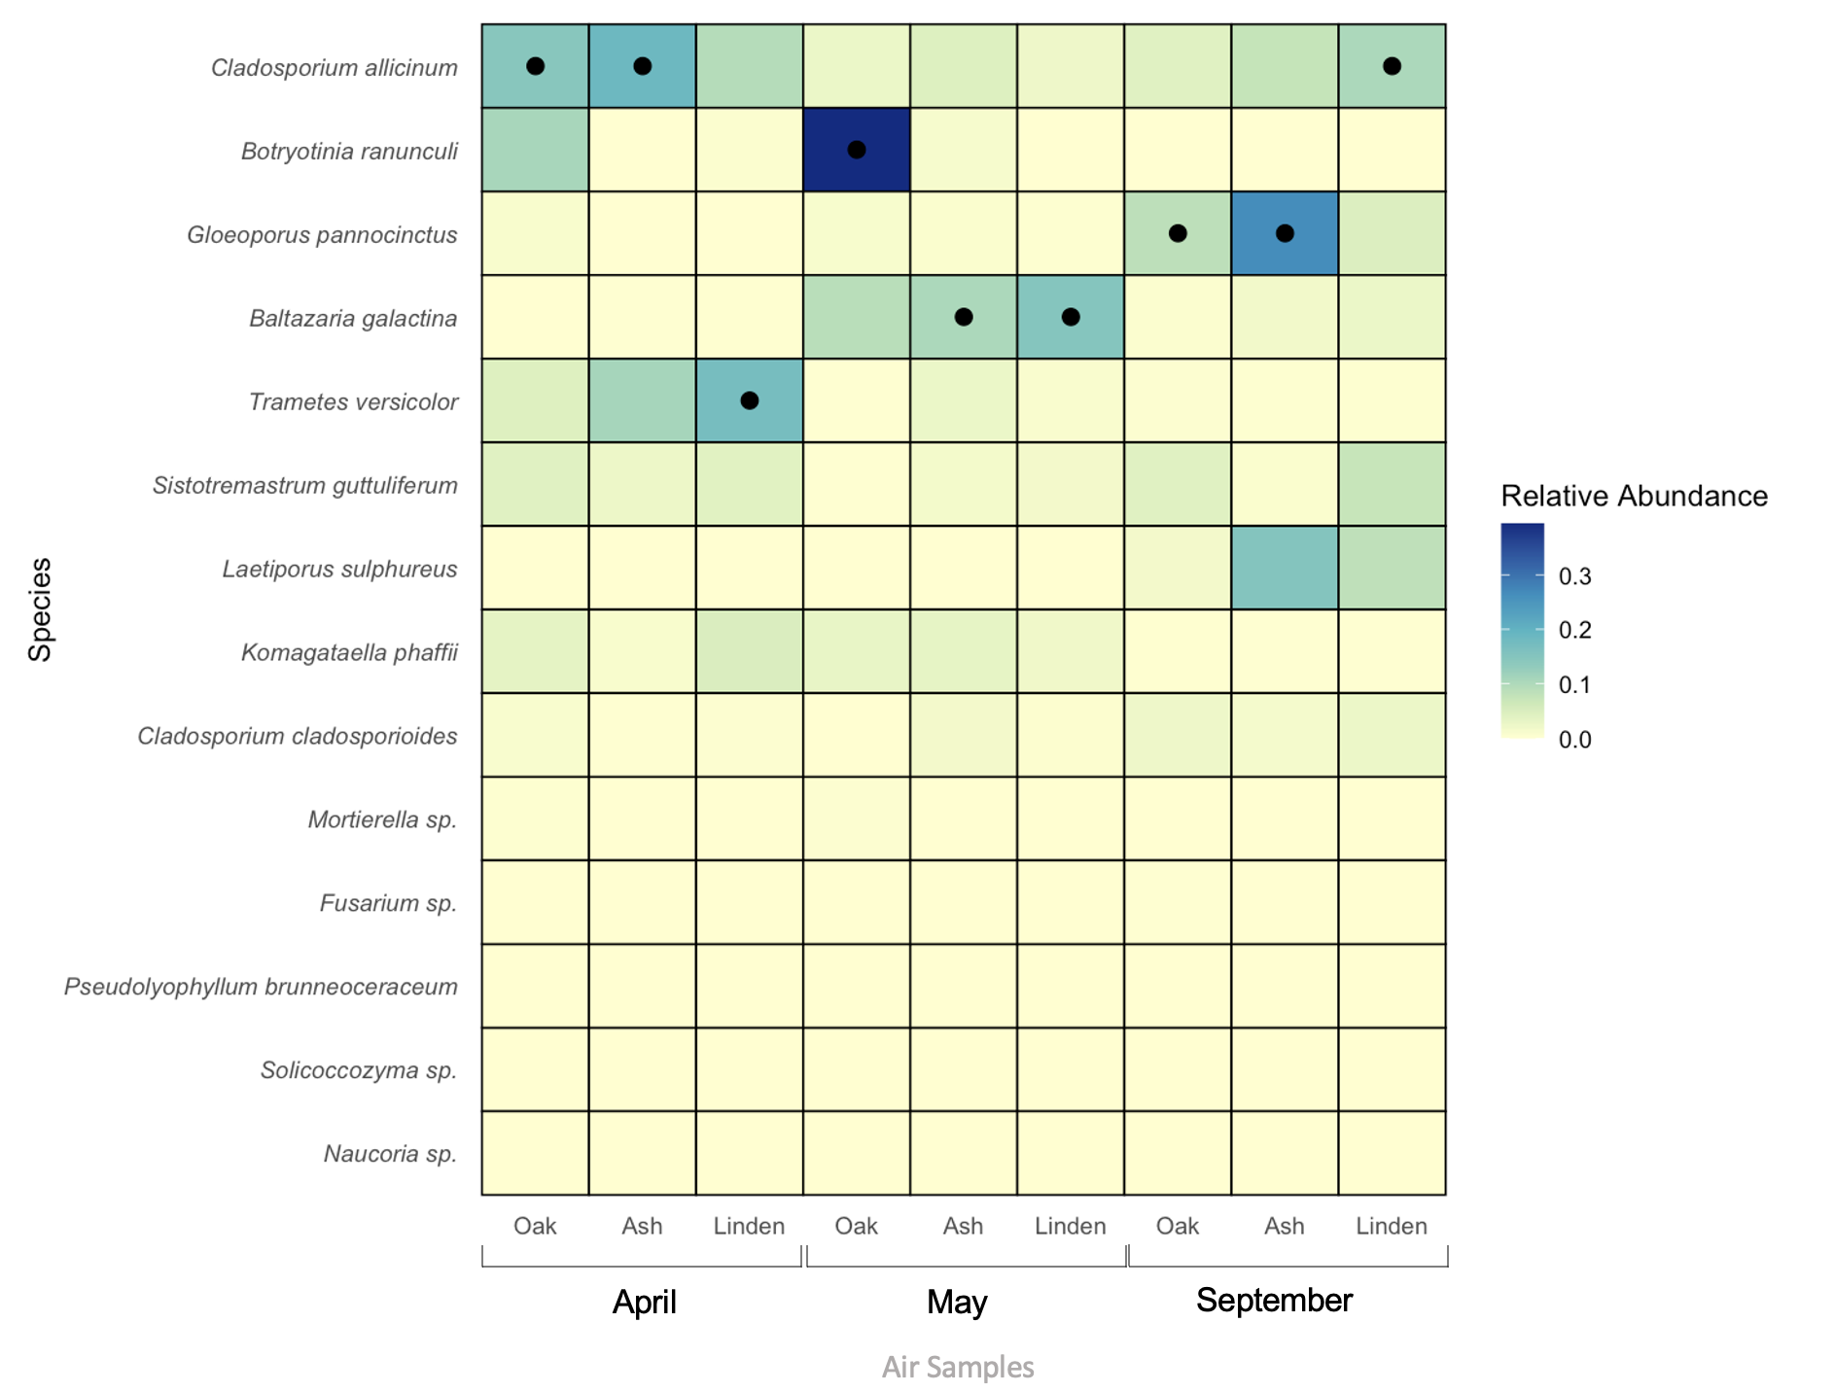
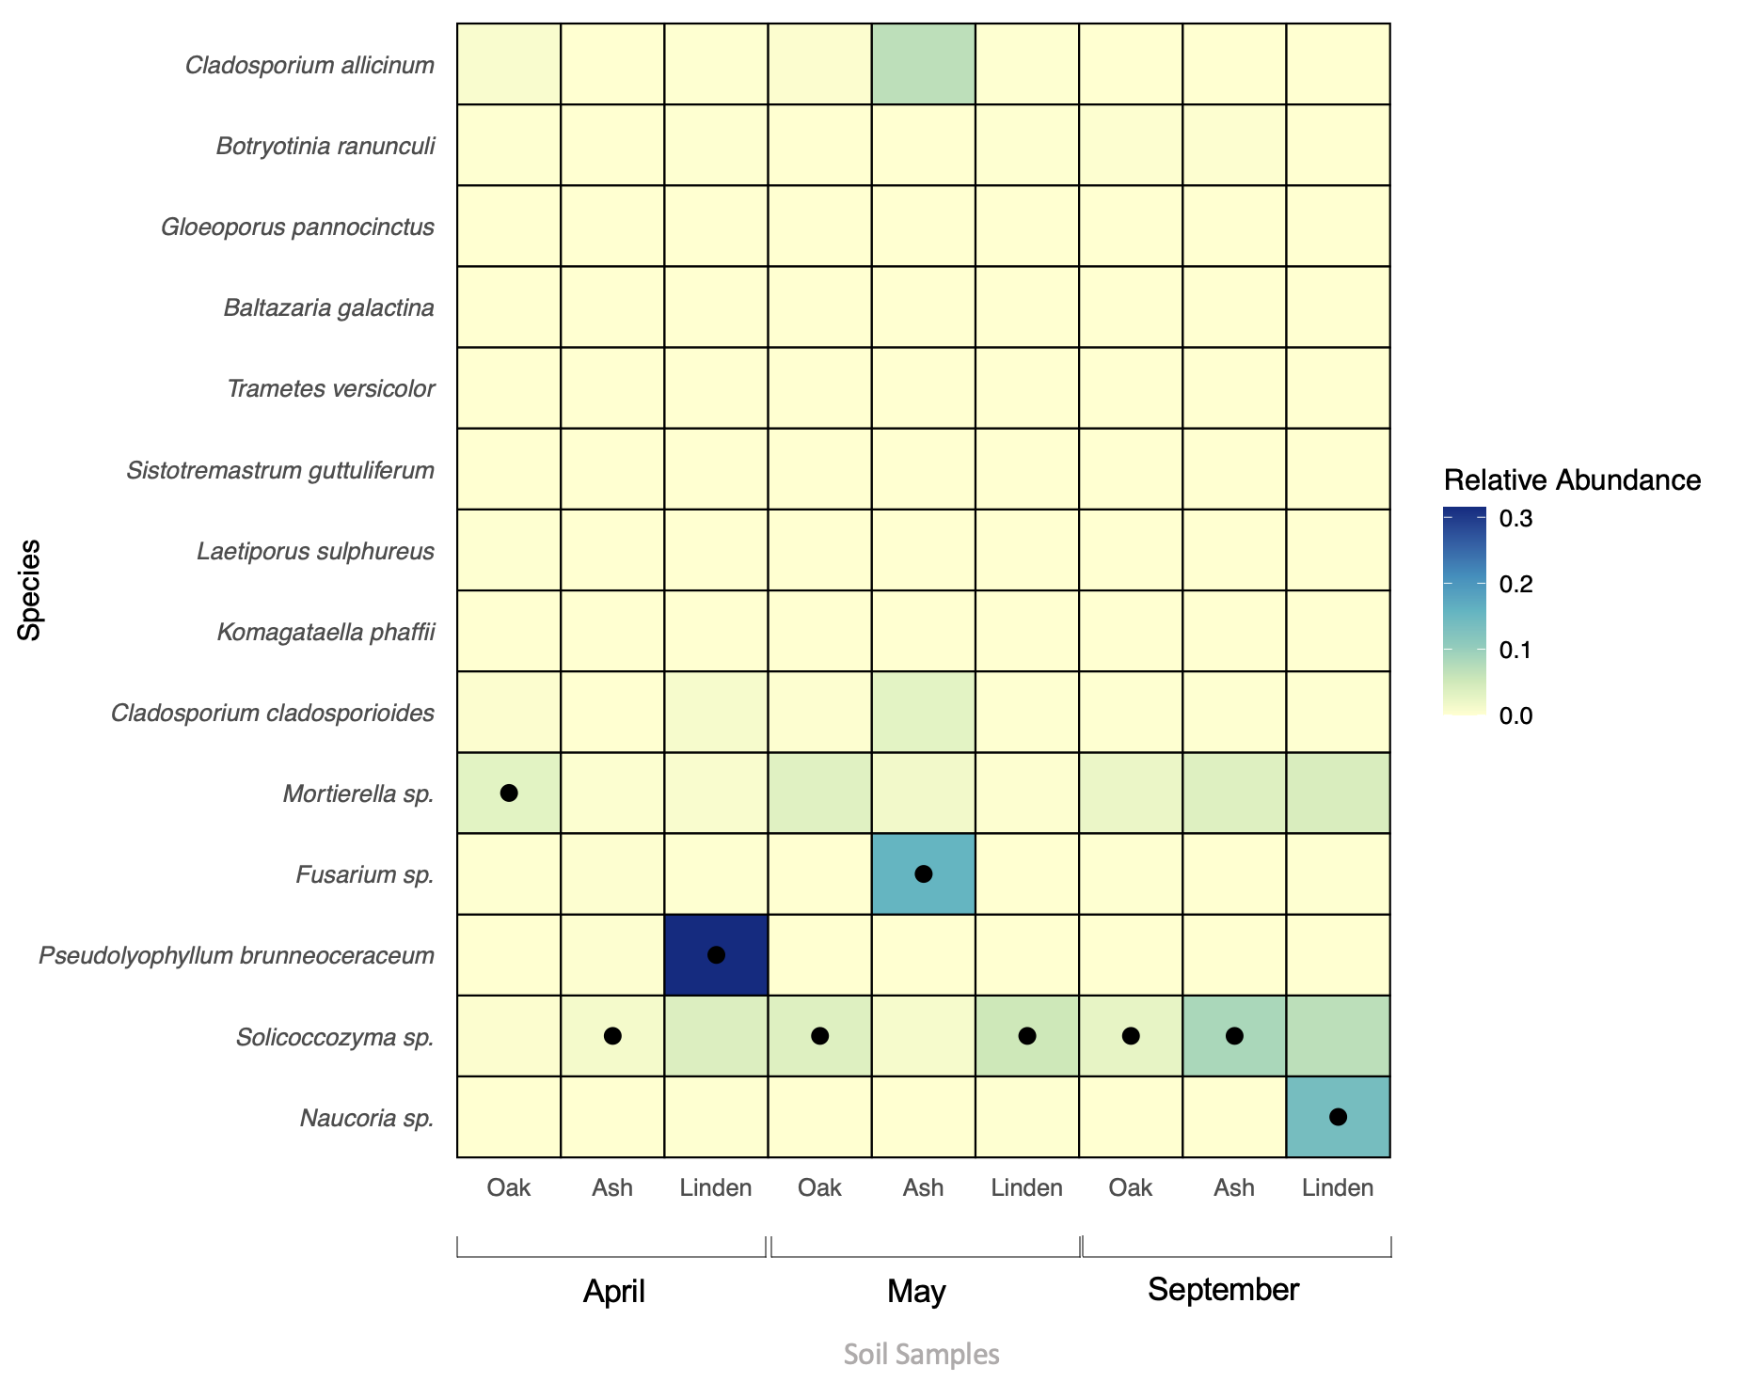
FUNGI
Air
Soil
Fig 11: Heat Map comparing most dominant fungal species

Slide 15
Fig 11: Comparison of mean relative abundance of the most dominant Fungal species in the air samples

Slide 16
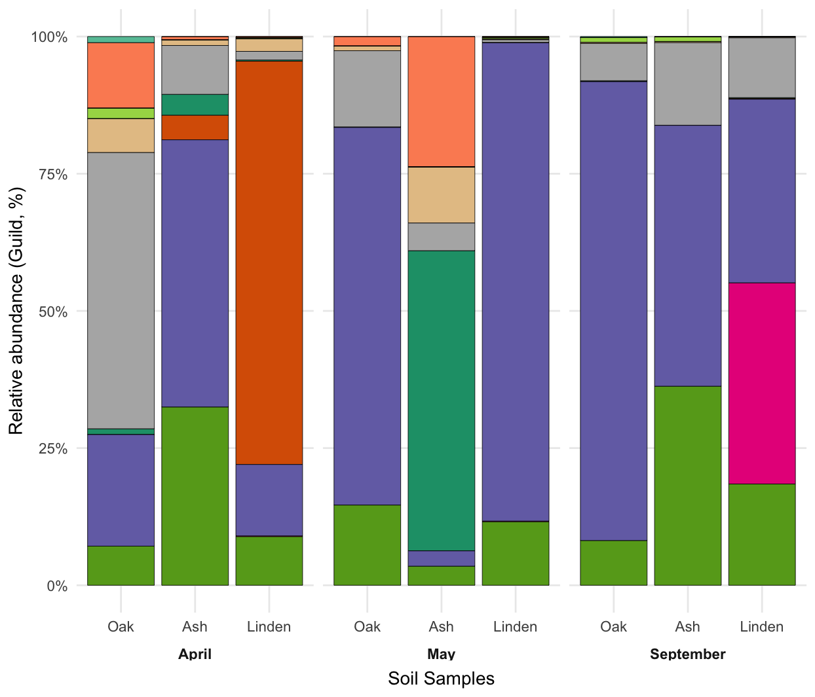
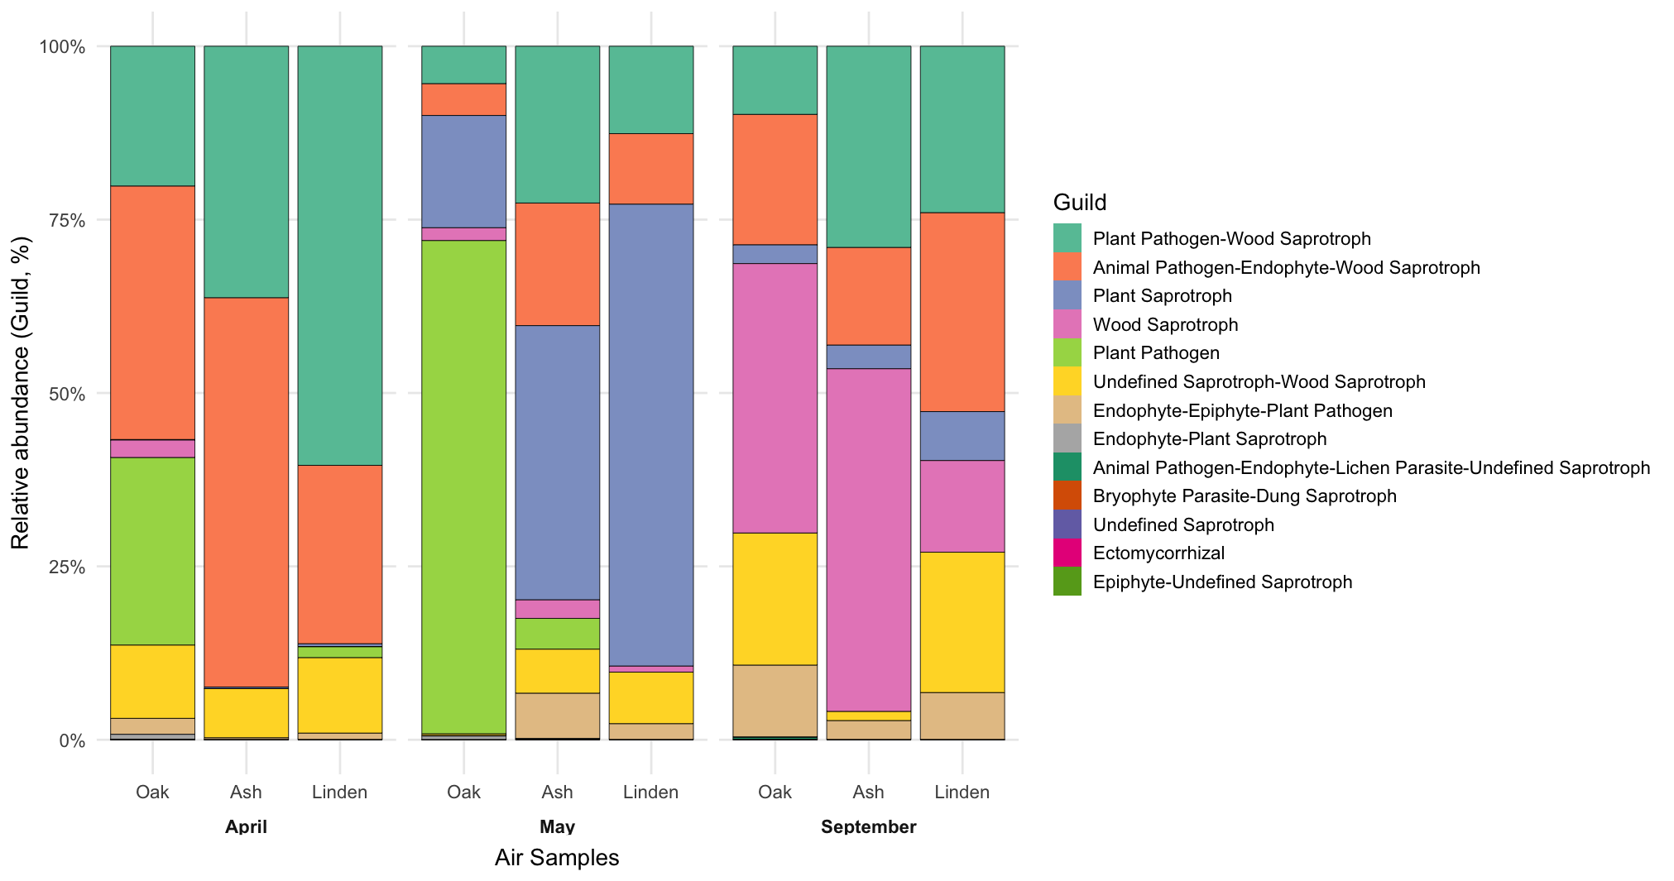
FUNGuild based classification
Fig 13: Comparison of to most dominant guilds in air a) Soil and b) air samples

Slide 17
Conclusions:
For Bacteria, air samples showed lower diversity, mostly dominated by a few similar species like Pseudomonas spp. while soil samples were more diverse and even.
For Fungi, air samples showed relatively higher diversity, similar to the corresponding soil samples.
Microbial communities in soil and air were distinctly separated in composition.
Seasonality and tree type did not seem to influence the composition and diversity of PBAPs in our dataset.
Soil does not appear to be the original source of the dominant airborne microbes, suggesting the need for further exploration of other sources like phyllosphere and surrounding water bodies.
17

Slide 18
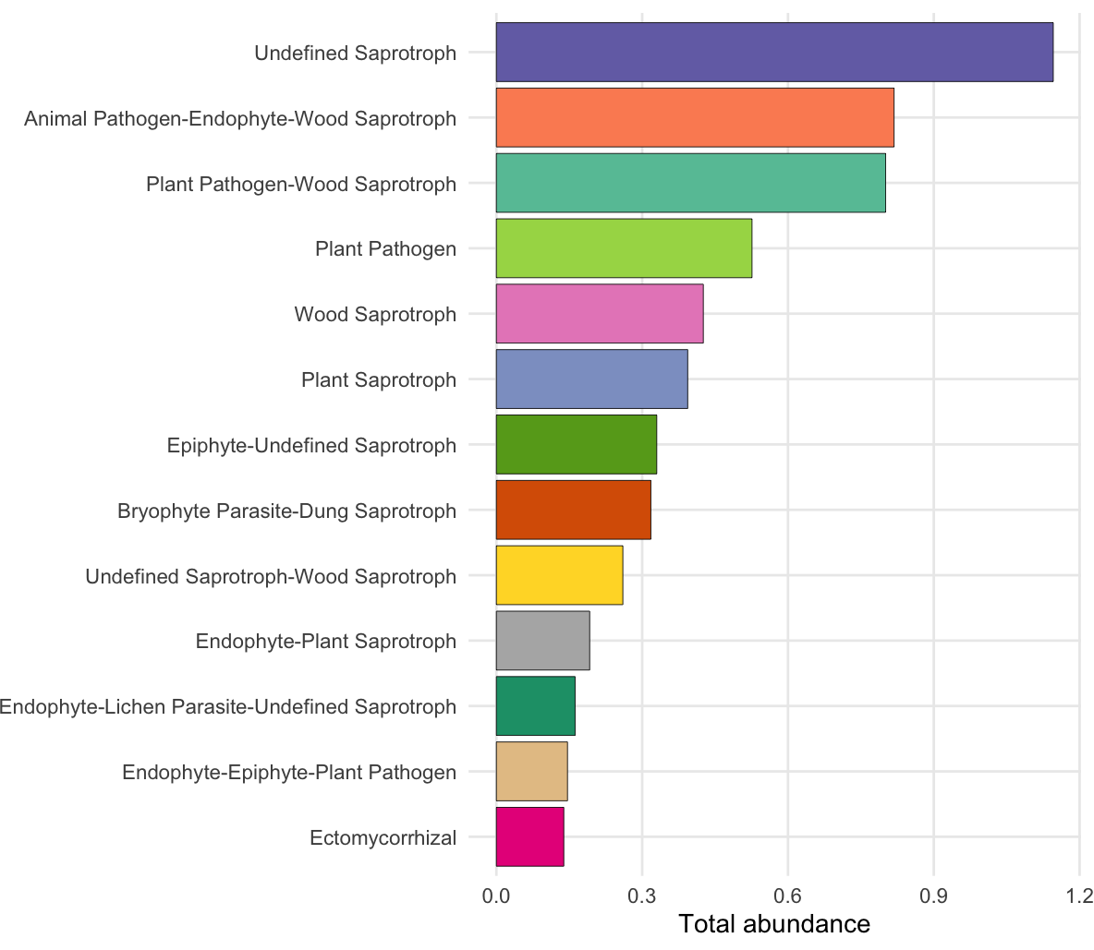
For the ecological role analysis of Fungi, the soil samples showed dominance of saprotrophs and epiphytes while the air samples showed dominance of wood saprotrophs and plant/animal-pathogens.
The presence of potential plant as well as animal pathogens in the air reinforces the importance of air monitoring.
Fig 14: Most dominant guilds in soil and air samples

Slide 19
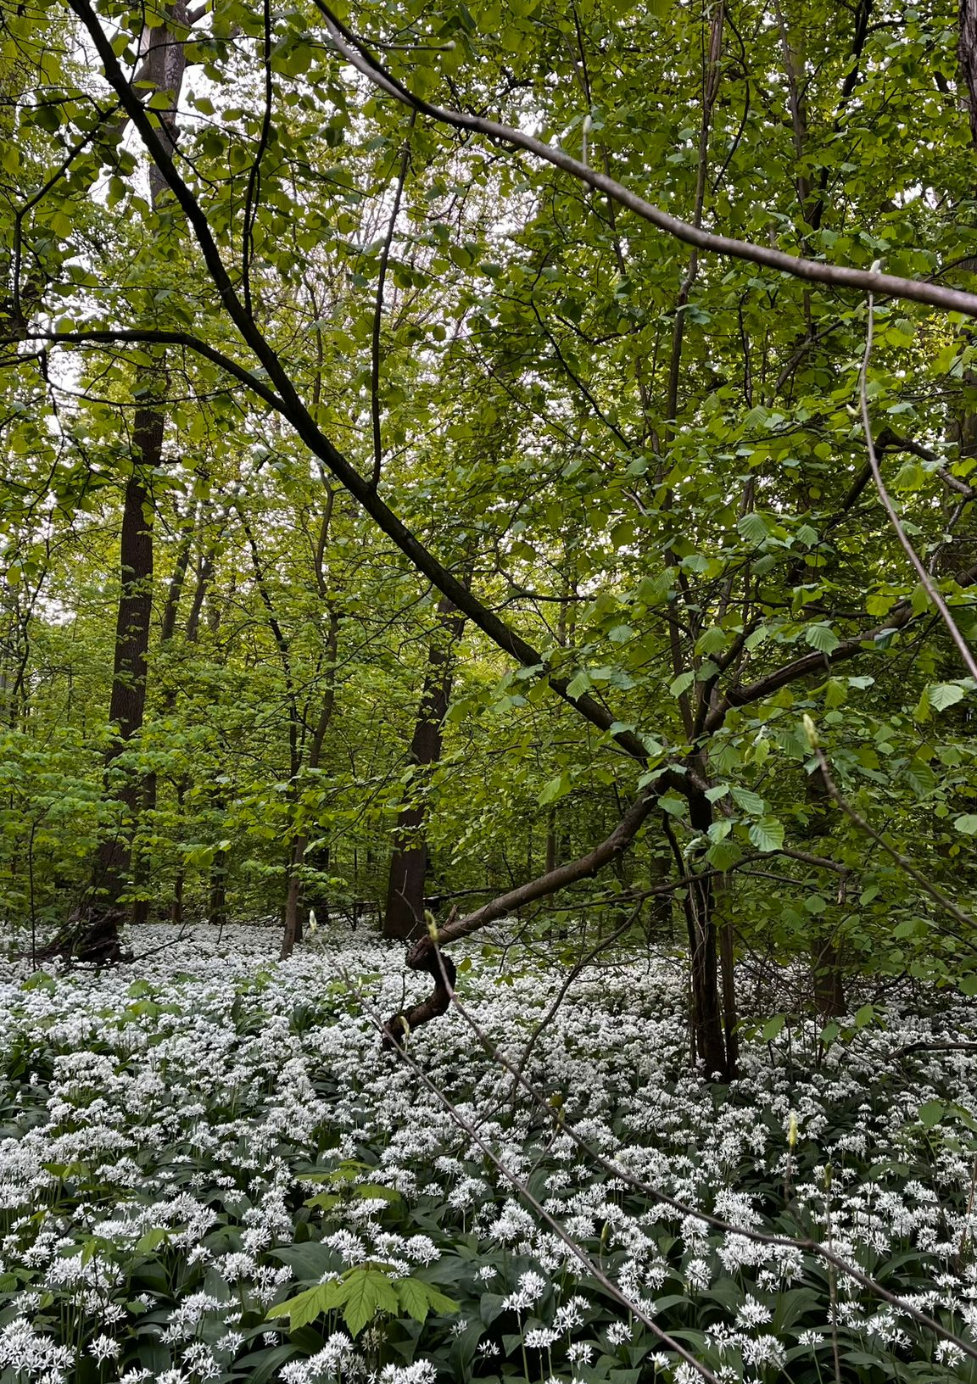
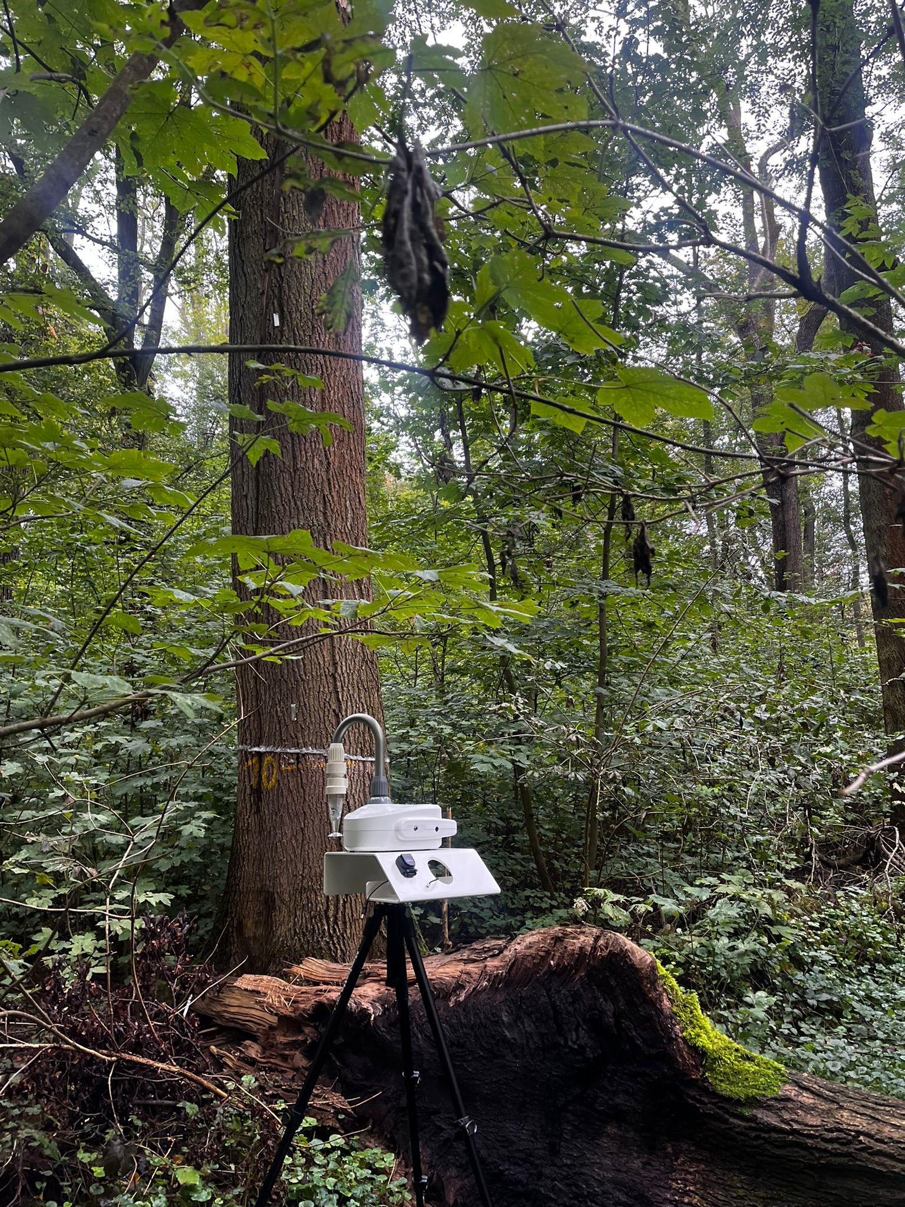
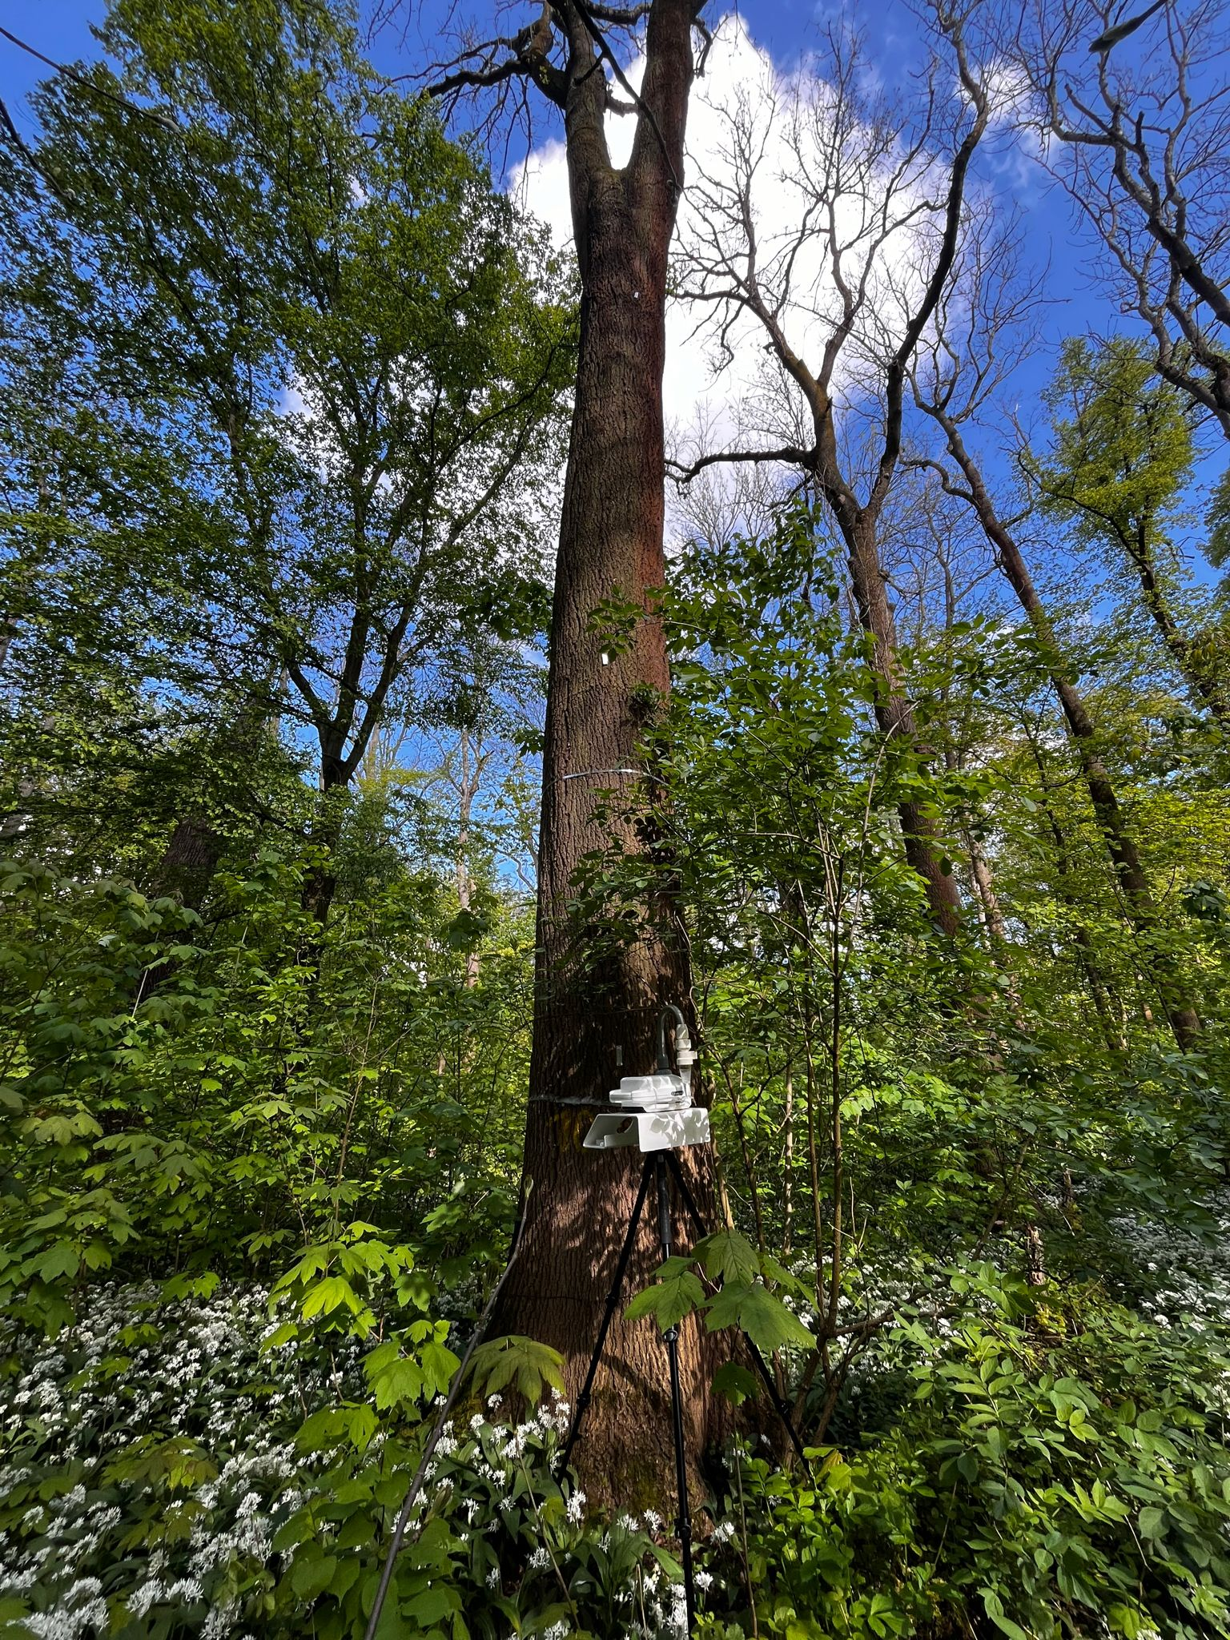
THANK YOU!

Slide 20
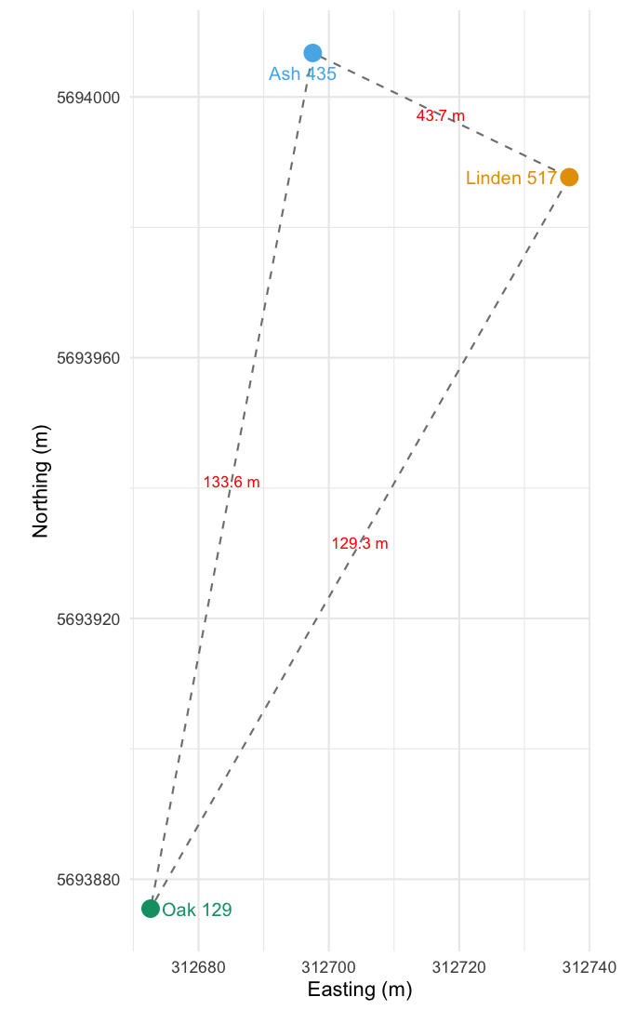
Supplementary material-
 | Tree | Sample type | Month
A | Ash | Air | April
B | Ash | Air | May
C | Ash | Air | September
D | Ash | Soil | April
E | Ash | Soil | May
F | Ash | Soil | September
 | Tree | Sample type | Month
M | Oak | Air | April
N | Oak | Air | May
O | Oak | Air | September
P | Oak | Soil | April
Q | Oak | Soil | May
R | Oak | Soil | September
 | Tree | Sample type | Month
G | Linden | Air | April
H | Linden | Air | May
I | Linden | Air | September
J | Linden | Soil | April
K | Linden | Soil | May
L | Linden | Soil | September

Slide 21
For 16S
Primers- 16S V3-V5 region (459 bp approx)
341F: CCTACGGGNGGCWGCAG
799R: CYAACGAGCGCAACCC
Sequencing depth: Between ~100k–120k usable reads per sample (after QC).
Amplicon size: ~460 bp (16S V3–V5 region, 341F, 799R).
Primers: Standard 341F/799R primer set, removed during preprocessing.
Bacteria (16S V3–V5, 341F–799R primers)
Databases: NCBI NT + RDP
Reads per sample (raw to non-chimeric):
Raw data (initial reads): ~125,099
Non-chimeric reads (after removing chimeras): ~36,837
ASVs after length filtering (final usable reads): ~35,067

Slide 22
For ITSFngs
The fungal sequencing targeted the ITS region (Internal Transcribed Spacer).
Primers- ITS1F (forward) and ITS2R (reverse).
ITS1F: CTTGGTCATTTAGAGGAAGTAA
ITS2 R: GCTGCGTTCTTCATCGATGC
Amplicon size: 250–600 bp (variable across fungal taxa).
Databases: UNITE Fungi + NCBI NT + UNITE INSD All eukaryotes.
Analysis: ASV (DADA2) pipeline
Reads per sample (raw to non-chimeric):
Raw: 102,544 – 151,989 (median 134,596)
Non-chimeric: 84,494 – 118,802 (median 110,264, mean ~107,930)
Overall retained (final vs. raw): ~82.7%

Slide 23
Month | Mean temperature (average) | RH% (average) | Wind speed (average)
April 2024 | ≈ 11.3 °C | 72 % | 14.3 km/h
May 2024 | ≈ 15.9°C | 75 % | 15 km/h
September 2024 | ≈ 13°C | 69 % | 21.1 km/h

